Slide 1
Tri-Valley Life Sciences Summit
2023 Sponsorship Prospectus

Slide 2
Tri-Valley Life Sciences Summit
TRI-VALLEY LIFE SCIENCES SUMMIT SPONSORSHIP
2022 Summit Snapshot
$17.5K Raised
165 Attendees
13 Sponsors

Slide 3
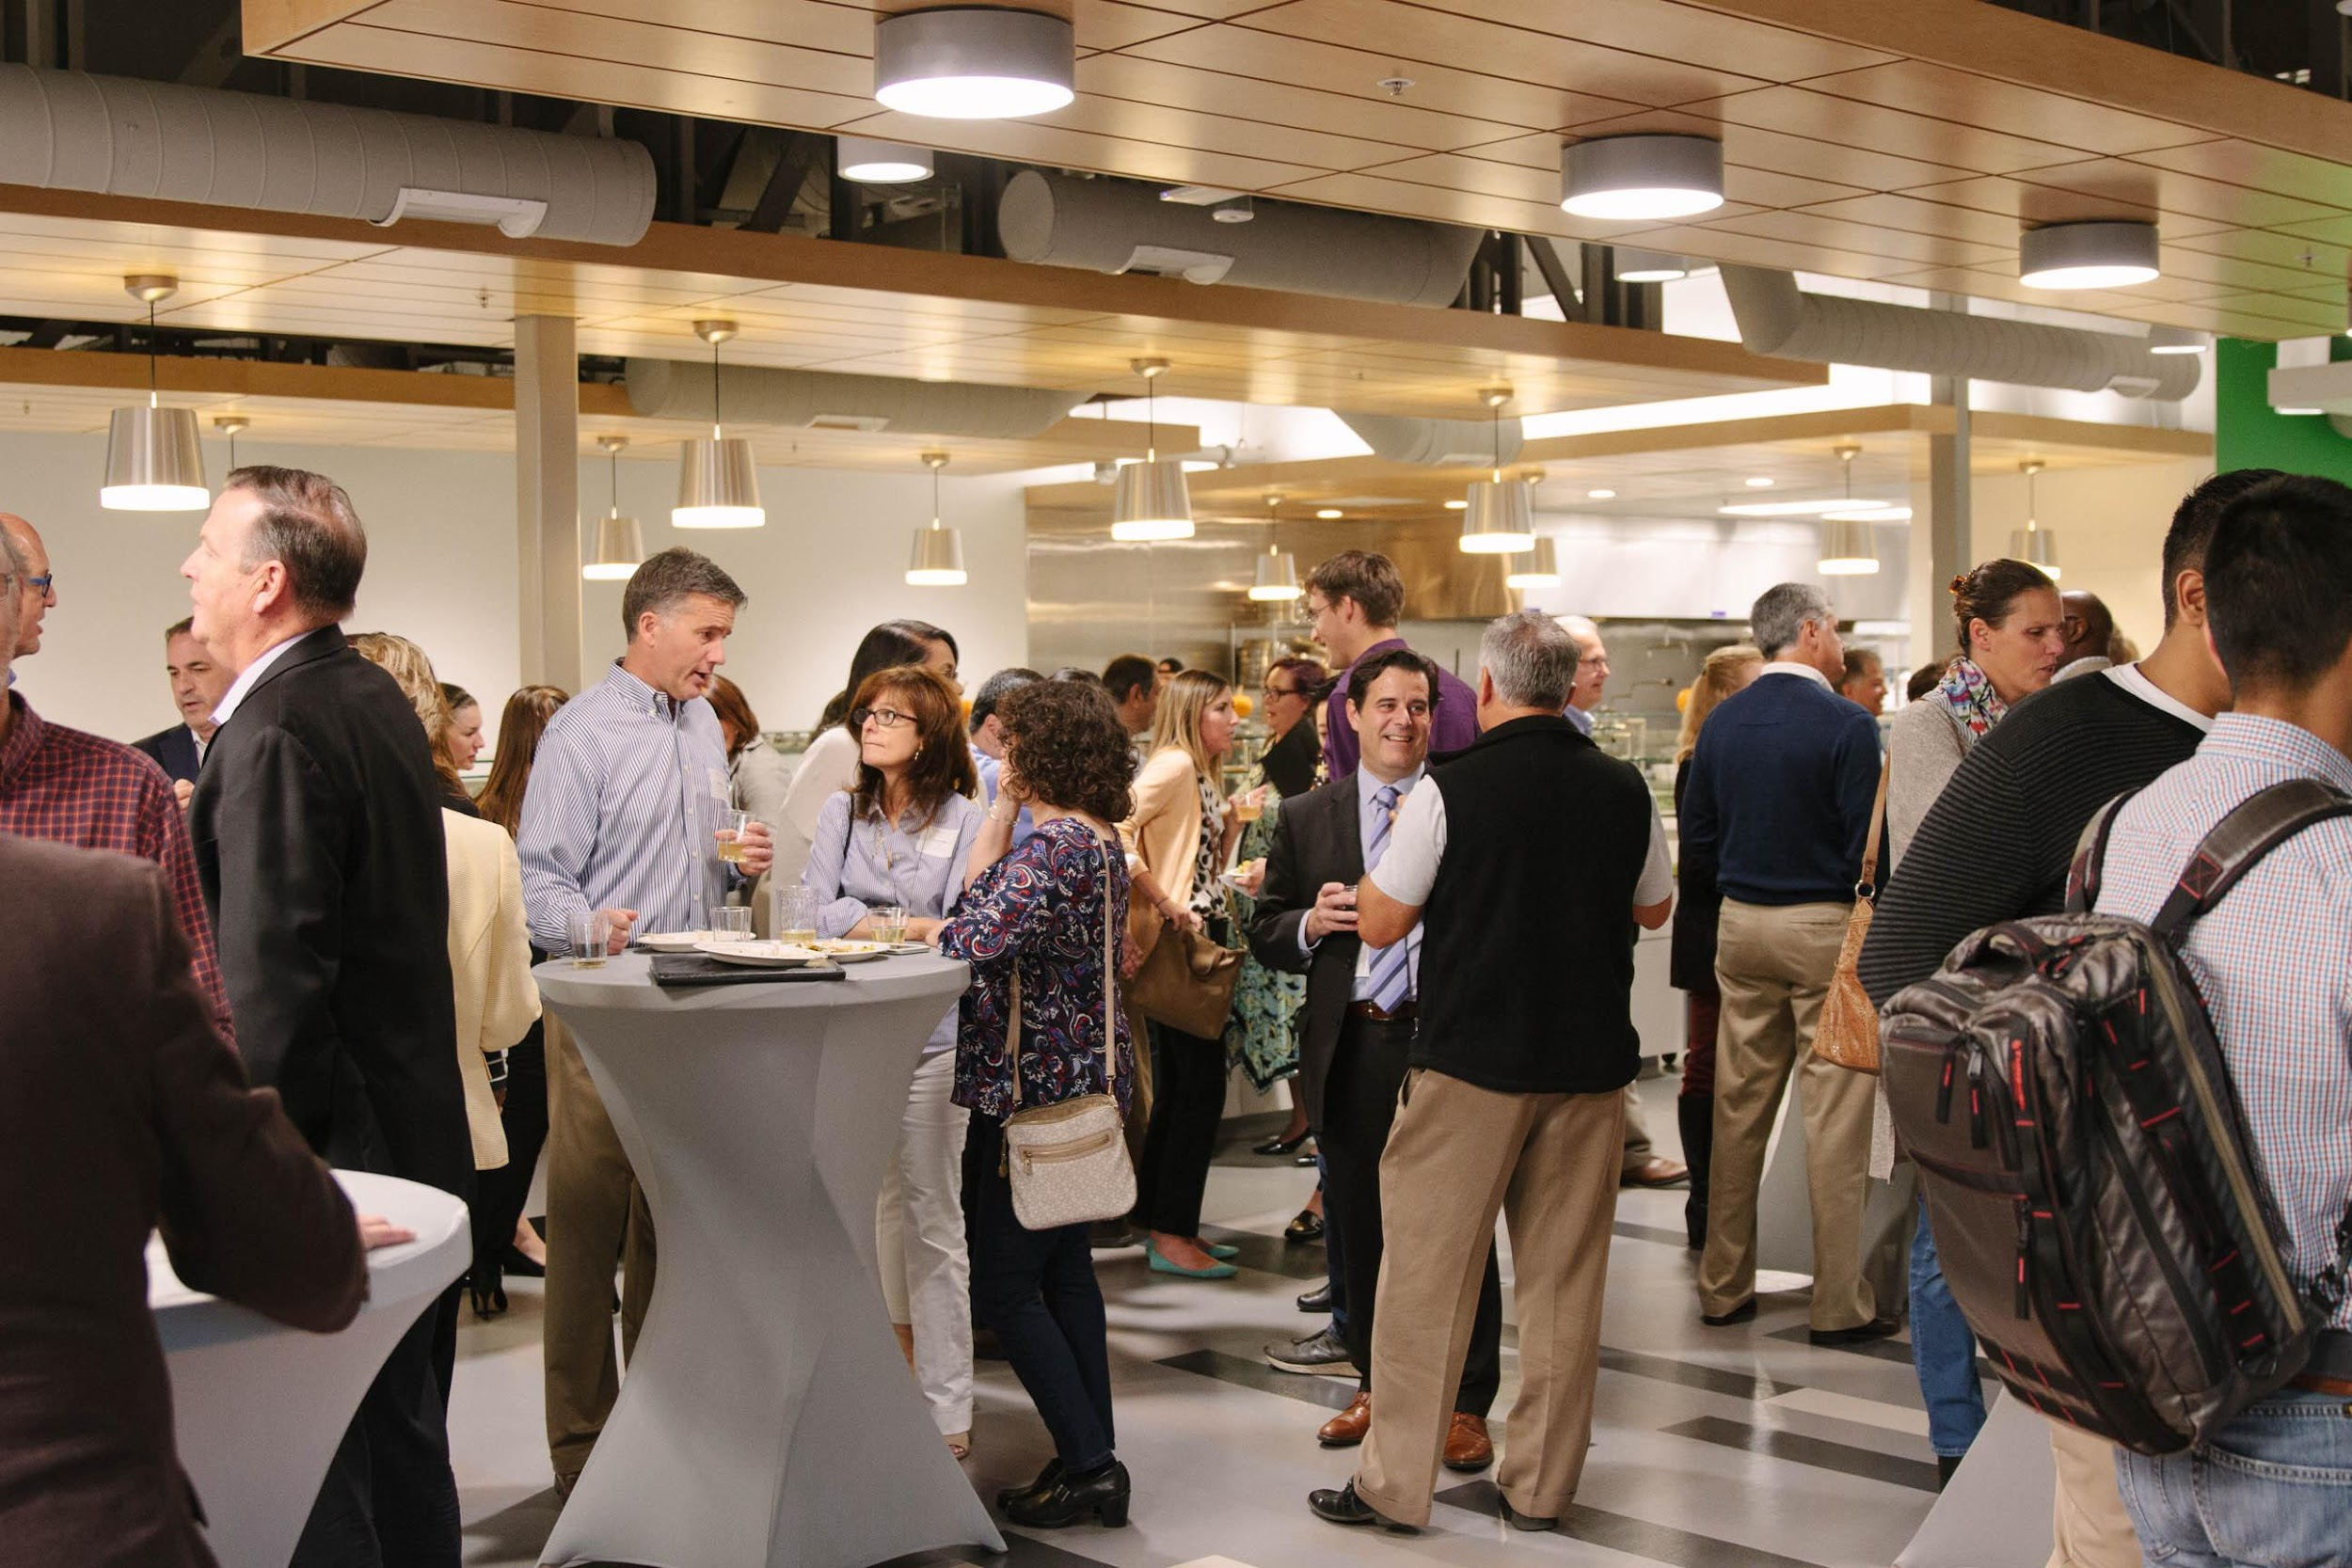
2023 Event Info
TRI-VALLEY LIFE SCIENCES SUMMIT SPONSORSHIP
Date: | October 18, 2023
Time: | 5 pm - 8:00 pm
Location: | Unchained Labs
Keynote Event: | Fireside Chat Featuring John Hanna, CEO, Apton Bio

Slide 4
Proposed Event Agenda
TRI-VALLEY LIFE SCIENCES SUMMIT SPONSORSHIP
5 pm | Networking
5:45 pm | Welcome
6:00 pm | Fireside chat
6:30 pm | Panel of life sciences entrepreneurs
7:00- 8:00 pm | Closing remarks and networking

Slide 5
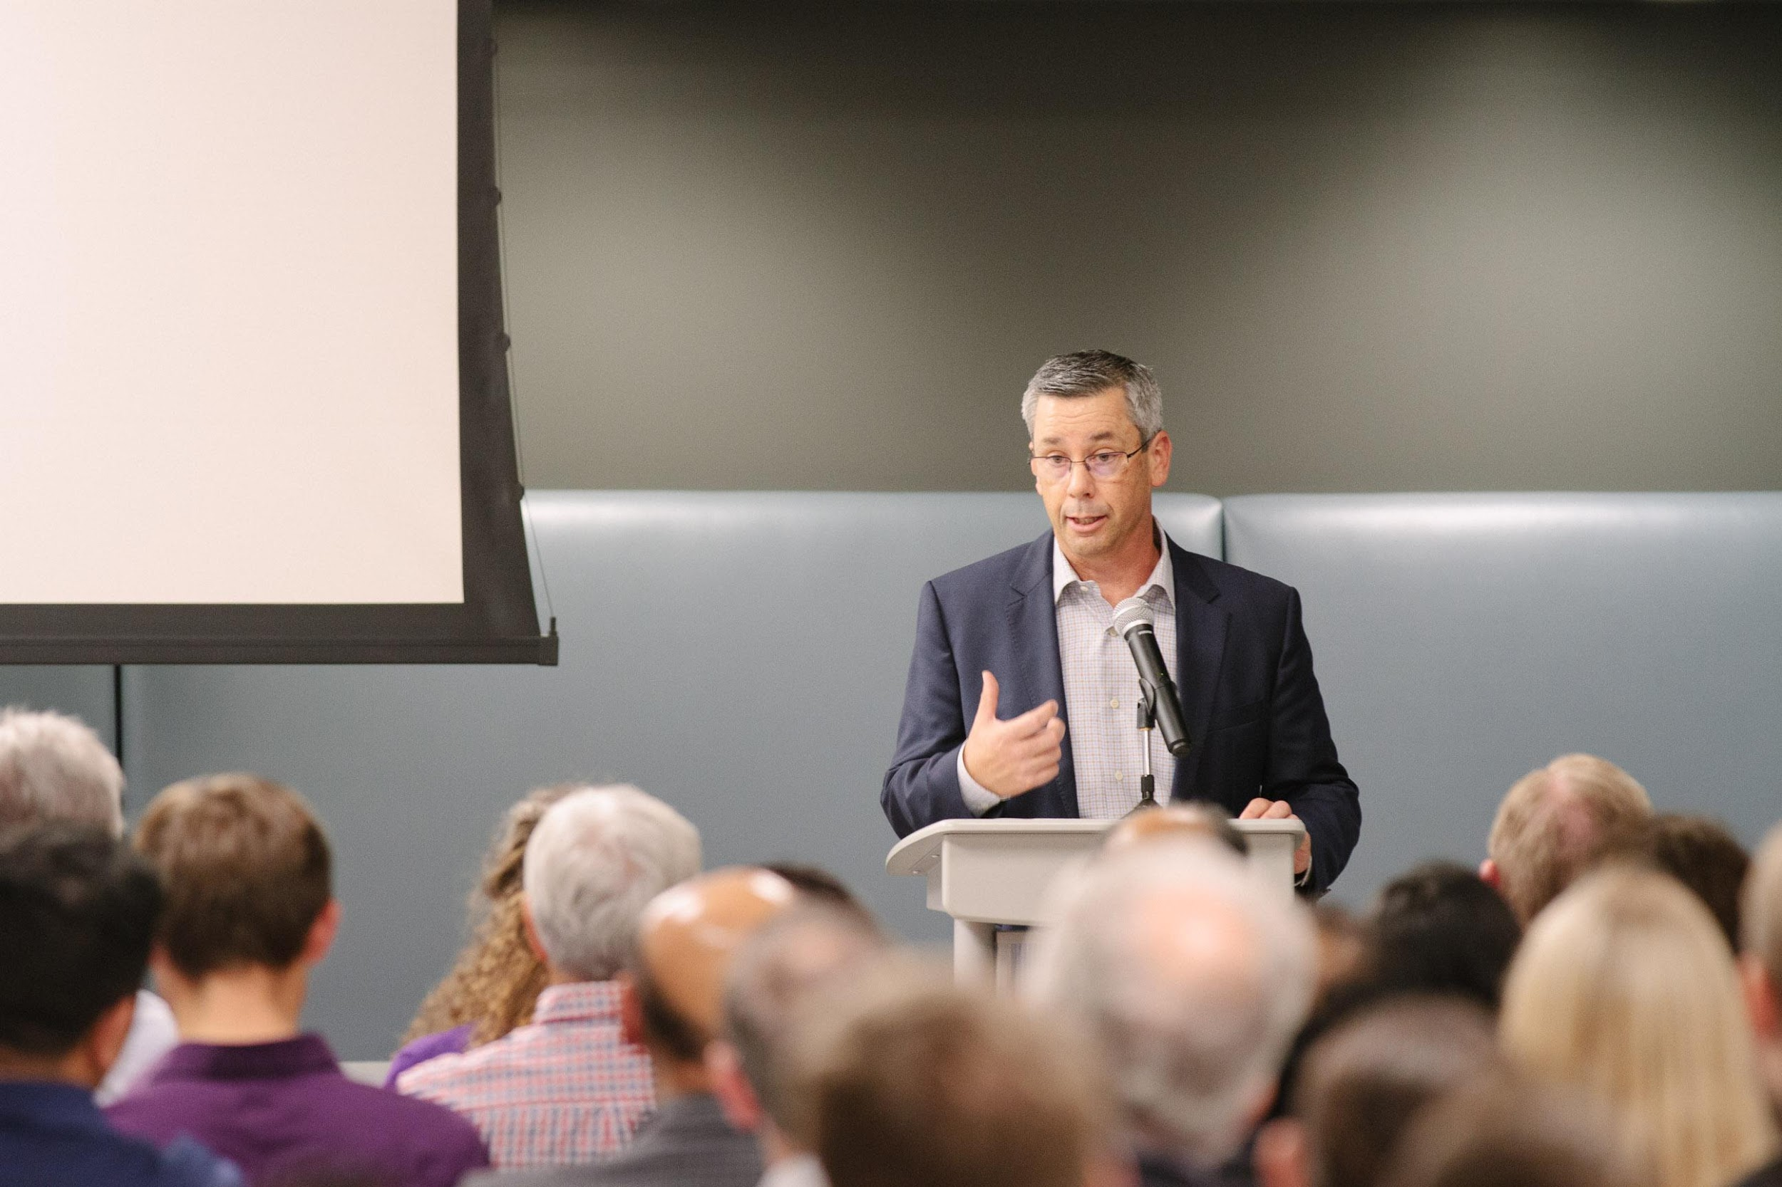
Available Sponsorship Tiers
TRI-VALLEY LIFE SCIENCES SUMMIT SPONSORSHIP
Ecosystem Sponsor (up to 3): $2,500
Event Sponsor (no limit): $500

Slide 6
Presenting Sponsor (not available)
TRI-VALLEY LIFE SCIENCES SUMMIT SPONSORSHIP
Up to 2 - $5,000
Headline brand placement on event website and all marketing and PR materials
Headline brand placement on post-event content
Speaking slot at the beginning of the Summit
Opportunity to co-develop a session for the Summit*
* Best efforts will be made to accommodate sponsor desires, but Summit organizers have final say over content development.

Slide 7
Ecosystem Sponsor
TRI-VALLEY LIFE SCIENCES SUMMIT SPONSORSHIP
Up to 3- $2,500
Prominent brand placement on event website and selected marketing and PR materials.
Company acknowledgment and description during the Summit
* Best efforts will be made to accommodate sponsor desires, but Summit organizers have final say over content development.

Slide 8
Event Sponsor
TRI-VALLEY LIFE SCIENCES SUMMIT SPONSORSHIP
Event Sponsor - $500
Brand placement on event website and on event day

Slide 9
To Participate
TRI-VALLEY LIFE SCIENCES SUMMIT SPONSORSHIP
Contact… Yolanda Fintschenko | yolandaf@igateihub.org

