Slide 1
Tri-Valley Life Sciences Summit
2024 Sponsorship Prospectus

Slide 2
Tri-Valley Life Sciences Summit
TRI-VALLEY LIFE SCIENCES SUMMIT SPONSORSHIP
2023 Summit Snapshot
$16.5K Raised
175 Attendees
13 Sponsors

Slide 3
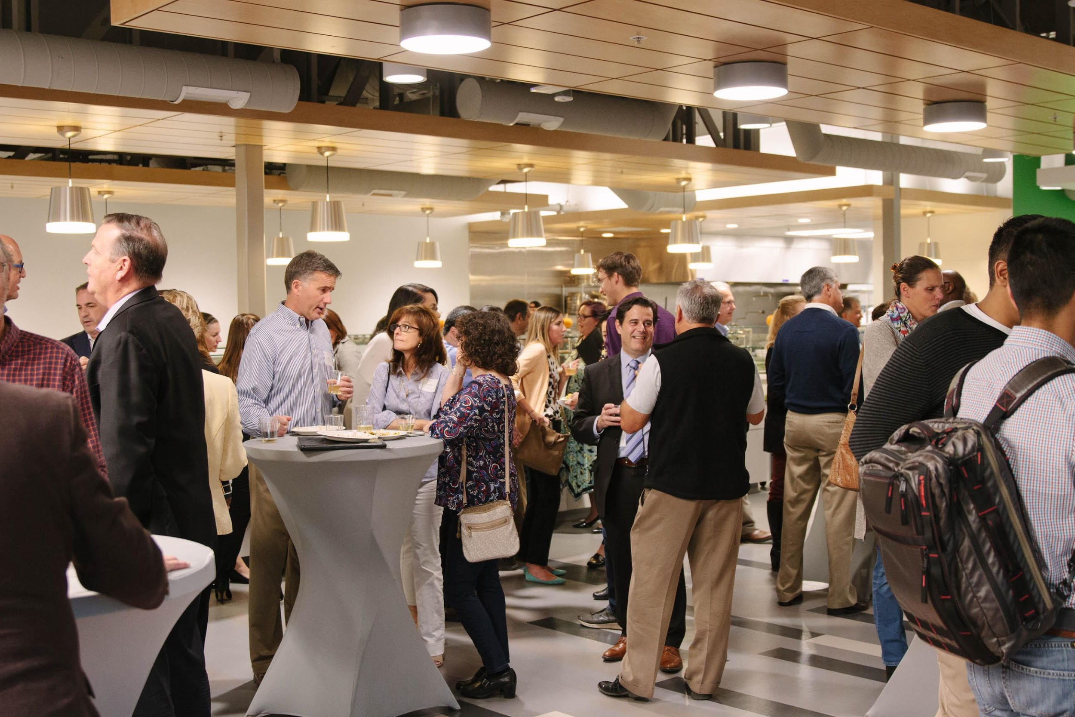
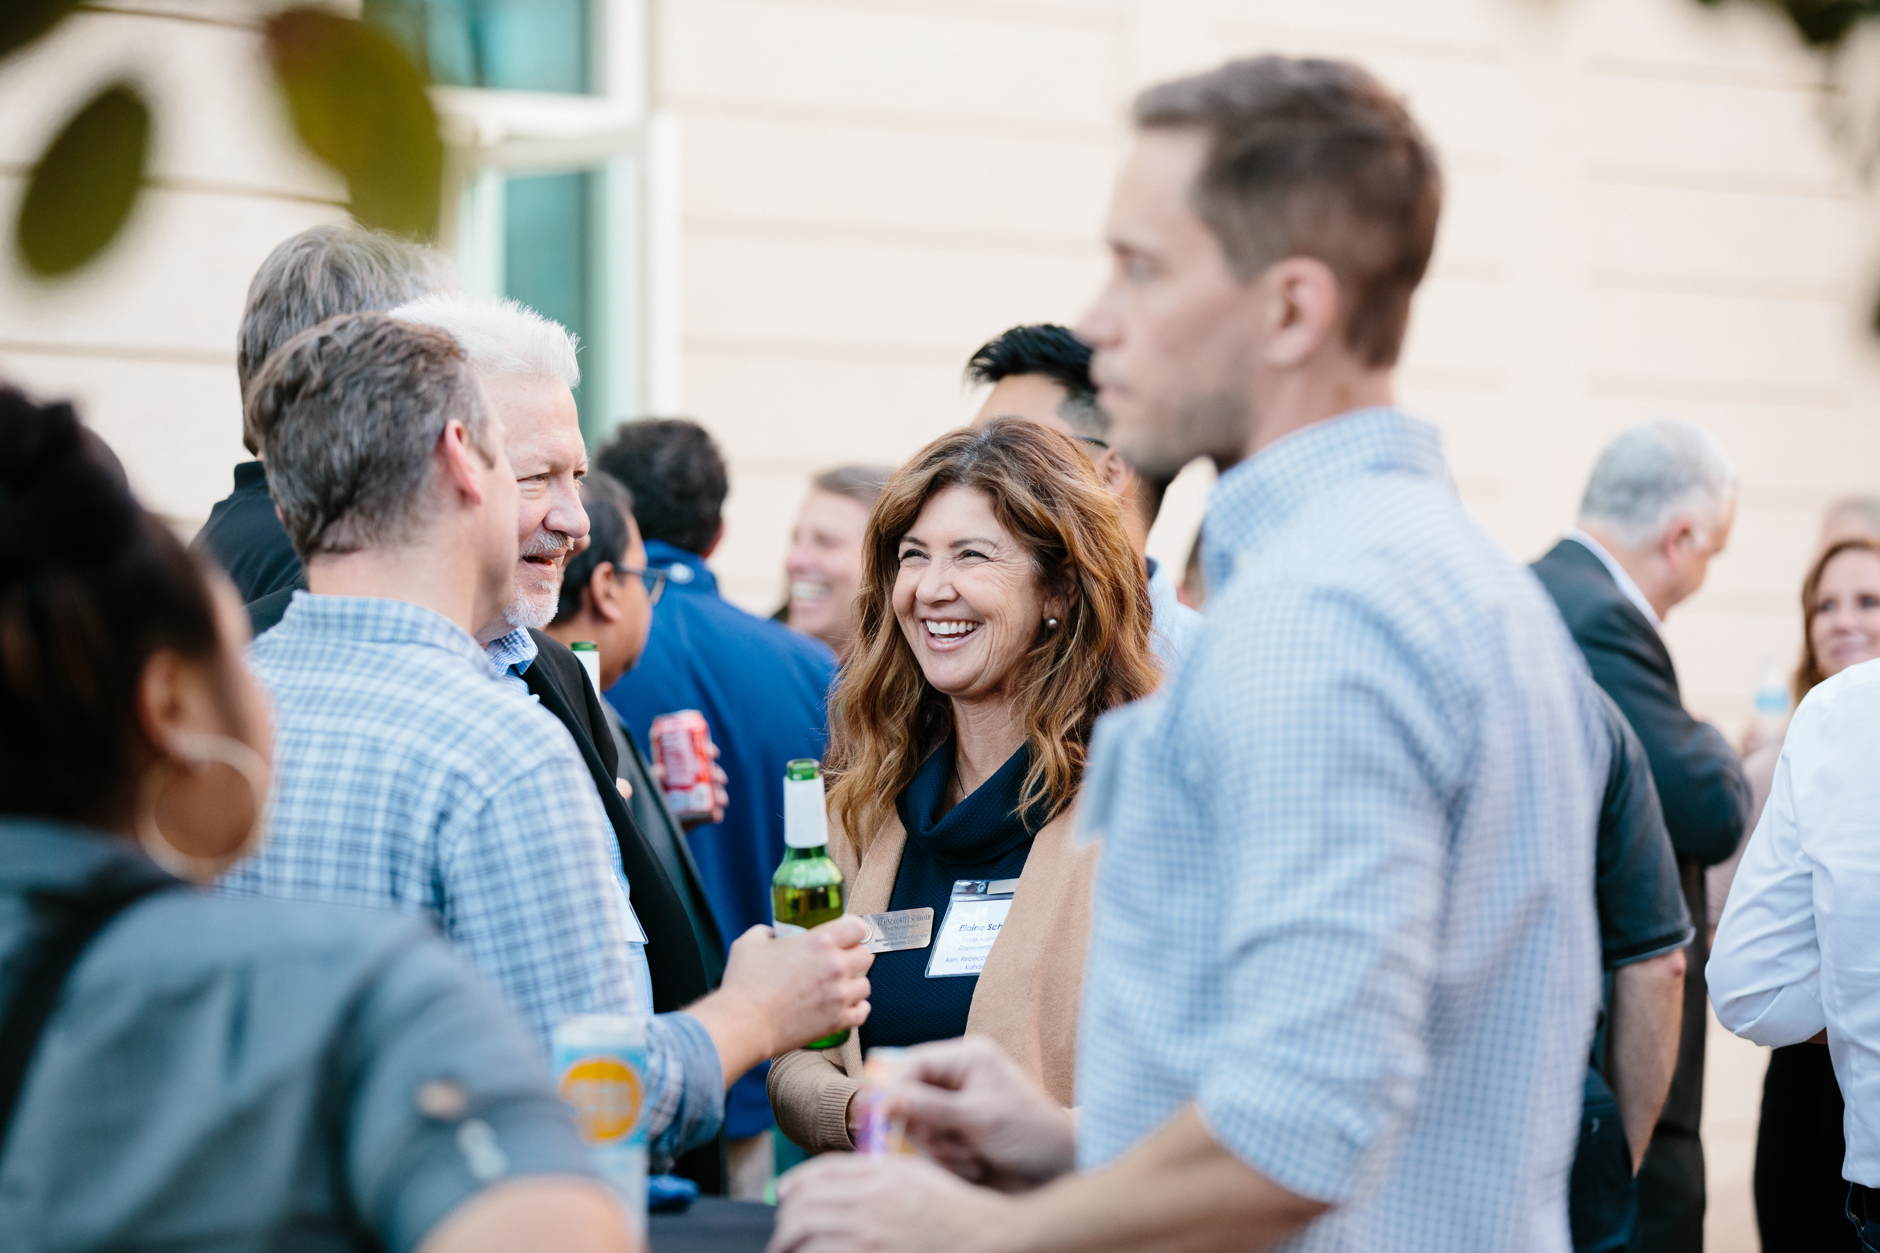
2024 Event Info
TRI-VALLEY LIFE SCIENCES SUMMIT SPONSORSHIP
Date: | October 23, 2024
Time: | 4:30 pm – 7:30 pm
Location: | Rosewood Commons
Keynote Event: | Fireside Chat

Slide 4
Proposed Event Agenda
TRI-VALLEY LIFE SCIENCES SUMMIT SPONSORSHIP
4:30 pm | Registration and Networking
5:30 pm | Welcome
5:45 pm | Fireside chat
6:15 pm | Panel of life sciences entrepreneurs
6:45- 7:30 pm | Closing remarks and networking

Slide 5
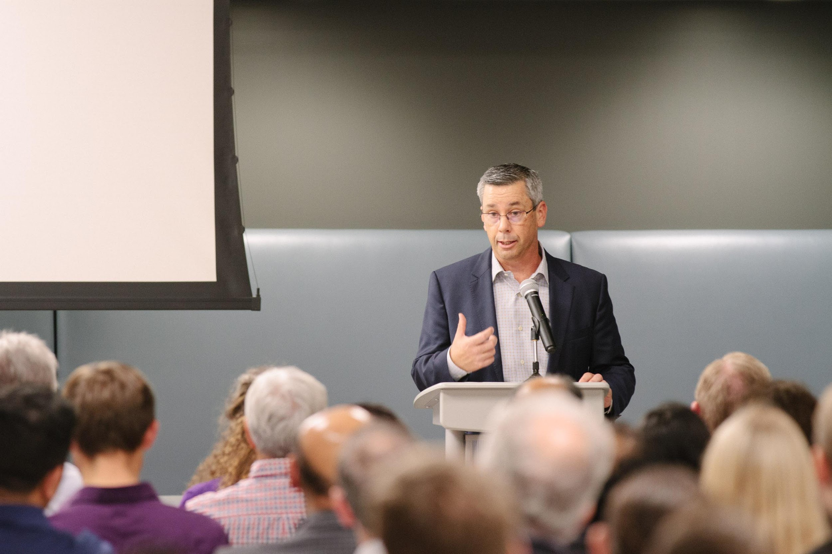
Available Sponsorship Tiers
TRI-VALLEY LIFE SCIENCES SUMMIT SPONSORSHIP
Ecosystem Sponsor : $2,500
Event Sponsor (no limit): $500

Slide 6
Ecosystem Sponsor
TRI-VALLEY LIFE SCIENCES SUMMIT SPONSORSHIP
$2,500
Prominent brand placement on event website and selected marketing and PR materials.
Company acknowledgment and description during the Summit
* Best efforts will be made to accommodate sponsor desires, but Summit organizers have final say over content development.

Slide 7
Event Sponsor
TRI-VALLEY LIFE SCIENCES SUMMIT SPONSORSHIP
Event Sponsor - $500
Brand placement on event website and on event day

Slide 8
To Participate
TRI-VALLEY LIFE SCIENCES SUMMIT SPONSORSHIP
Contact… Yolanda Fintschenko | yolandaf@igateihub.org

