Slide 1



INNOVATION
Fund Tri-Valley Economic Development - Fuel Growth by Advancing Innovation in Life Sciences, Women’s Health, Frontier Tech, and Artificial Intelligence
2025

Slide 2



MISSION
i-GATE INNOVATION HUB
i-GATE is a non-profit organization dedicated to building a thriving startup community in the Tri-Valley since 2010.
> 60 companies and >$450M raised

Slide 3

Upcoming Events
MISSION
Also supported by corporate sponsors like Stanford Health Care Tri-Valley.

Slide 4







FUNDING
i-GATE INNOVATION HUB
We are primarily funded by founding members representing Tri-Valley cities, counties, and national laboratories at the $430K level.

Slide 5

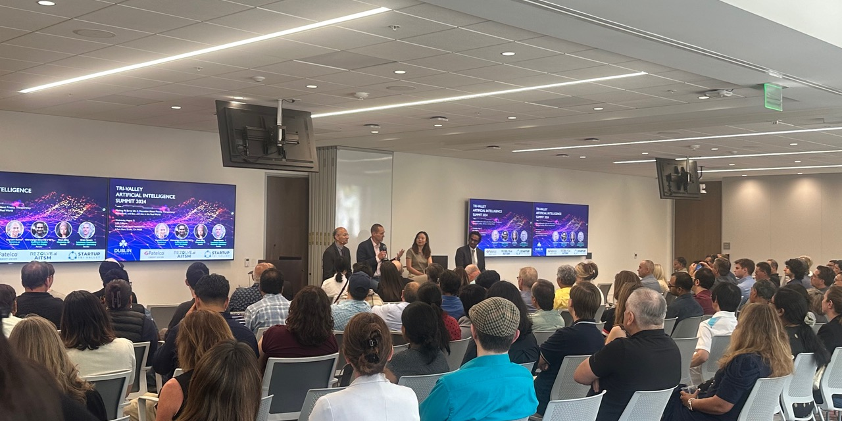

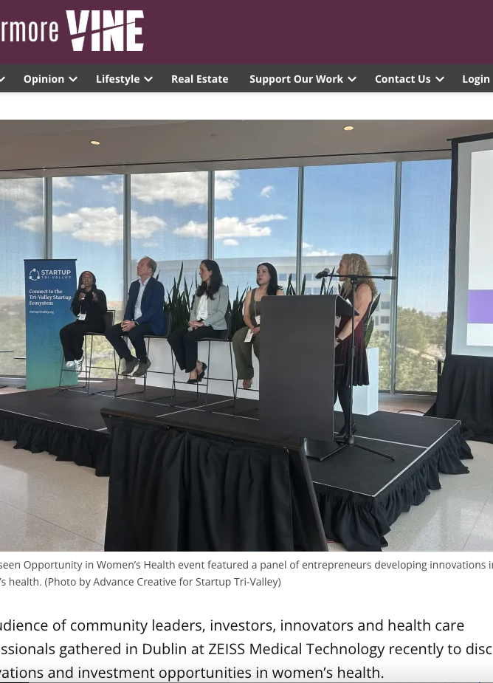
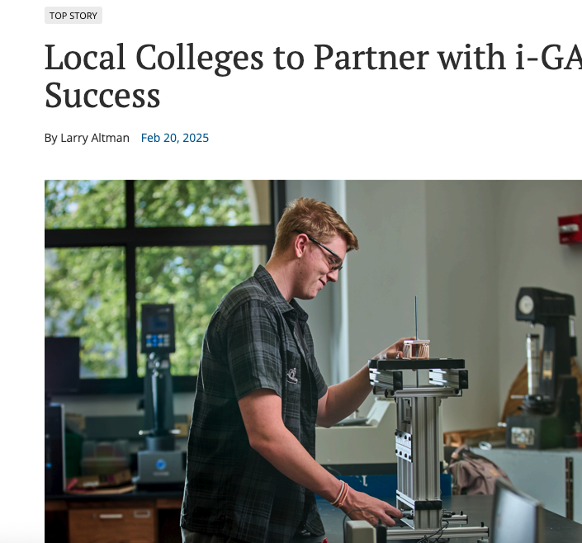
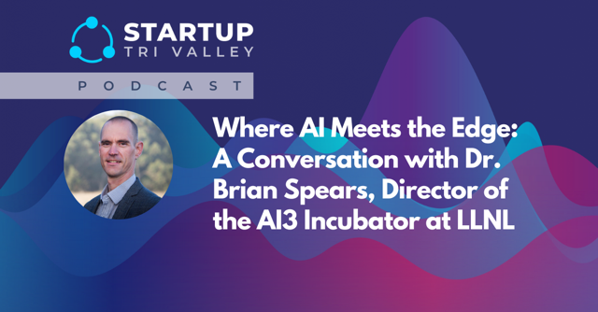
STV IMPACT
FY25 EVENTS
799 Attendees, 122% YOY
Attracted 105 Founders, 123% YOY
45 investors, 275% ⇧YOY
7 pieces of earned press 2024-2025
PODCAST
5 Seasons, 23 Episodes
>2200 downloads (all time)
34% Tri-Valley Cities (all time)
April 25|11 am - 12 pm

Slide 6
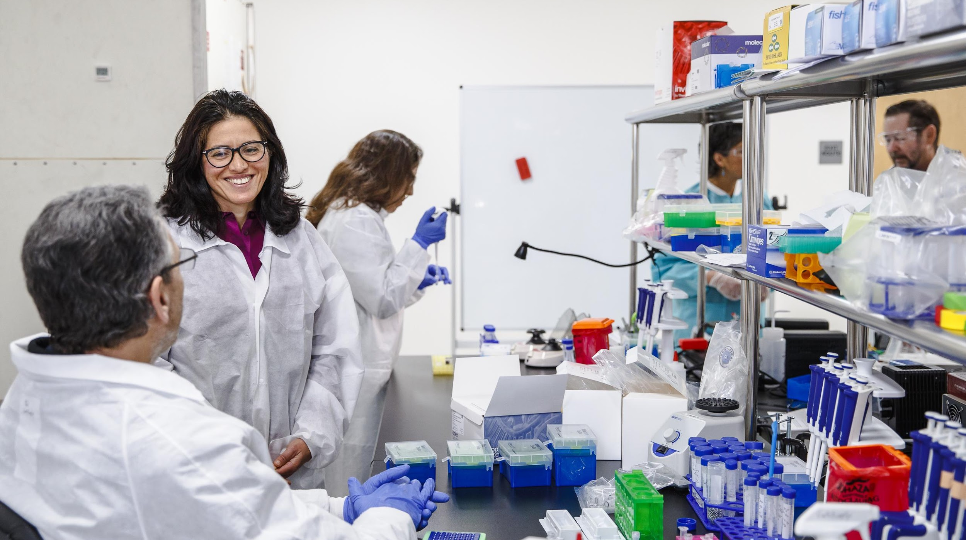
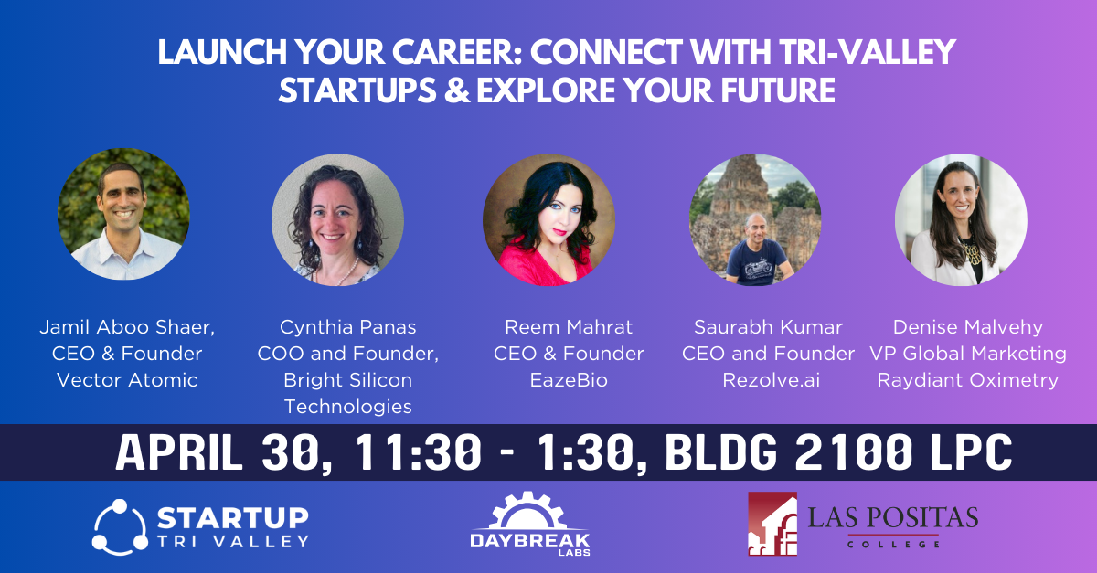



HOW
INCUBATOR
WORKFORCE DEVELOPMENT
ECOSYSTEM BUILDING
Daybreak Labs offers
Co-working lab and office space
Community
Expertise
Training
Differentiate our ecosystem by:
Creating a talent pipeline for startups
Overlapping founder networks into student life
Fostering an innovation campus at LPC
Startup Tri-Valley builds startup ecosystems in:
AI
Life Sciences
Women’s Health
Climate Tech
Via The Startup Tri-Valley Podcast and events.
Notes:
Comments: List events - number of events that we have at daybreak Labs, add DBL Founders talk to classes and clubs, Anyone that has space at the incubator would have to contribute to the student life in the following ways: Mentor interss, speak at clubs and classes, etc.

Slide 7
Connecting the Tri-Valley Startup Ecosystem
2025 Event Sponsorship Prospectus

Slide 8

Tri-Valley Life Sciences Summit
Startup Tri-Valley Event Sponsorship
2024 Summit Snapshot
$38K Raised
200 Attendees
14 Sponsors

Slide 9
Event Categories
Startup Tri-Valley Event Sponsorship
Industry | Event Type | Goal | Audience | Size
AI | Series | Thought Leadership Brand the region Connect the ecosystem | Policy makers, investors, founders, cornerstone companies | 50
 | Summit |  |  | 200 and growing
Life Sciences | Series |  |  | 50
 | Summit |  |  | >200
Women’s Health | Summit | Thought leadership Connect high net wealth individuals to investment funds and founders |  | 100
Climate Tech | Summit | Brand the region & build ecosystem |  | 150-200
 | Round Tables | Foster relationships between founders and funders and policy makers
 |  |  |  | 20-25

Slide 10
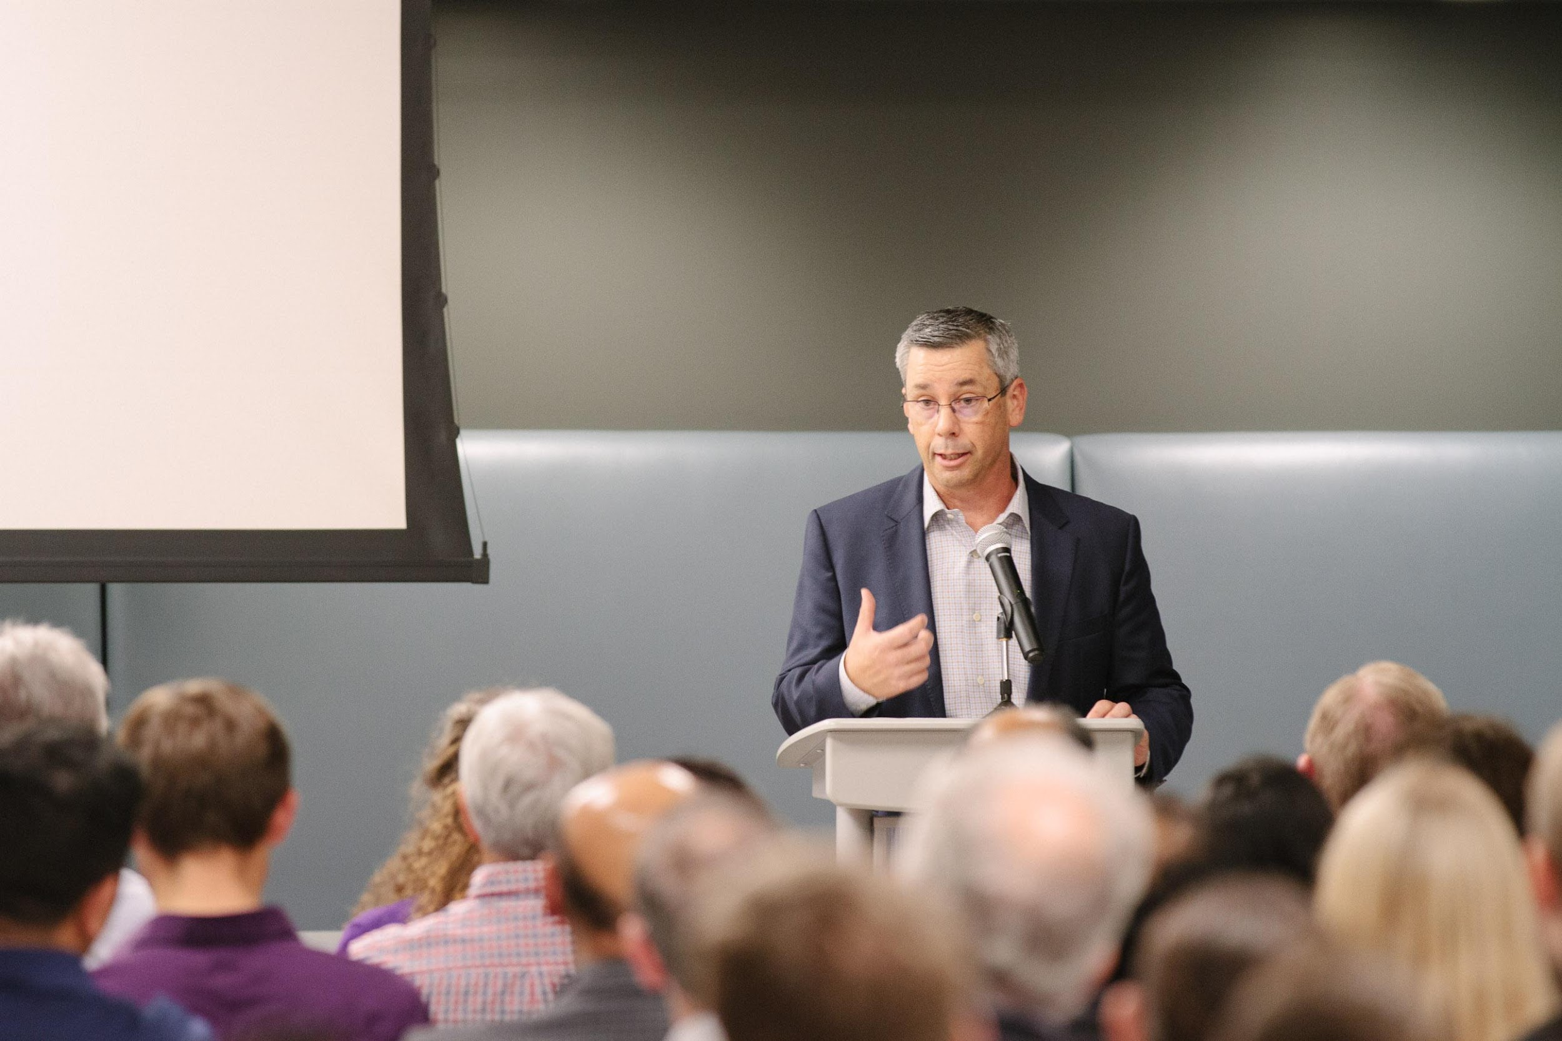
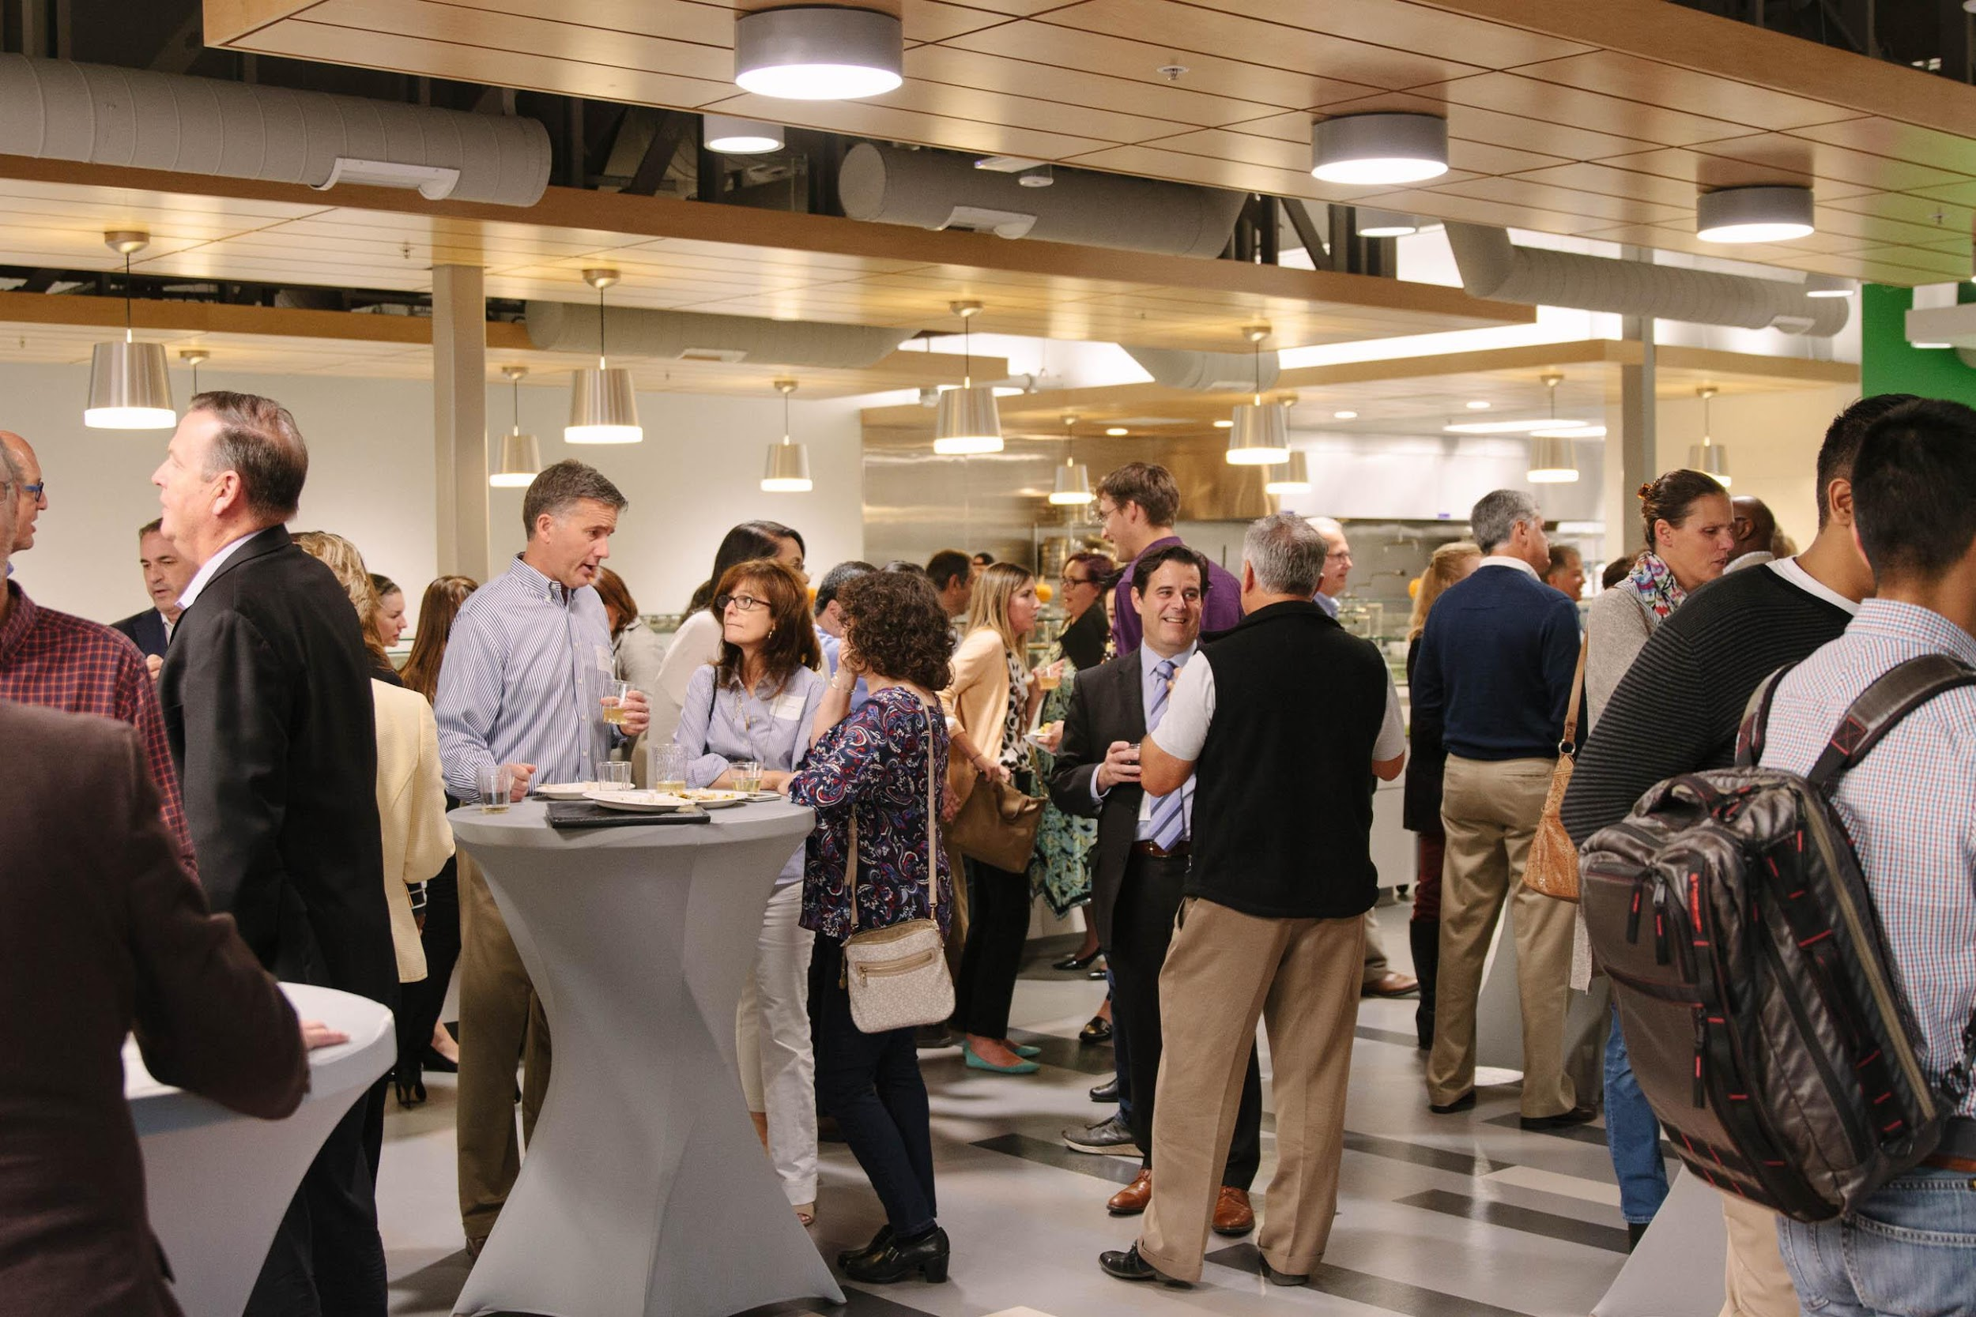
Available Sponsorship Tiers per Event
STARTUP TRI-VALLEY SUMMIT SPONSORSHIP
Title sponsor: $25K
Host: Provides space and refreshments,
& on-site logistics
Presenting Sponsor: $5K
Ecosystem Sponsor : $2,500
Event Sponsor: $500

Slide 11
Title Sponsor
STARTUP TRI-VALLEY SUMMIT SPONSORSHIP
$25K
Title sponsorship acknowledged in event main image used for all media
Featured in pre-event and post-event press release
Opportunity to provide or help determine event content
Company exec opens event
* Best efforts will be made to accommodate sponsor desires, but Summit organizers have final say over content development.

Slide 12
Hosting Sponsor
STARTUP TRI-VALLEY SUMMIT AND SERIES SPONSORSHIP
Facility, refreshments, and event logistics
Host role acknowledged in event main image used for all media
Featured as host in pre-event and post-event press release (for summits only)
Opportunity to provide or help determine event content
Company exec welcomes attendees
* Best efforts will be made to accommodate sponsor desires, but Summit organizers have final say over content development.

Slide 13
Presenting Sponsor
STARTUP TRI-VALLEY SUMMIT AND SERIES SPONSORSHIP
$5,000
Presenting sponsorship acknowledged in event main image used for all media’
Featured as presenting sponsor in pre-event and post-event press release (for summits only)
Opportunity to provide or help determine event content
Company representative may offer introductory remarks
* Best efforts will be made to accommodate sponsor desires, but Summit organizers have final say over content development.

Slide 14
Ecosystem Sponsor
STARTUP TRI-VALLEY SUMMIT SPONSORSHIP
$2,500
Prominent brand placement on event website and selected marketing and PR materials.
Company acknowledgment and description during the Summit
* Best efforts will be made to accommodate sponsor desires, but Summit organizers have final say over content development.

Slide 15
Booth Sponsor
STARTUP TRI-VALLEY SUMMIT AND SERIES SPONSORSHIP
$1000
Brand placement on event website and on event day
6 ft table at event

Slide 16
Event Sponsor
STARTUP TRI-VALLEY SUMMIT AND SERIES SPONSORSHIP
Event Sponsor - $500
Brand placement on event website and on event day

Slide 17
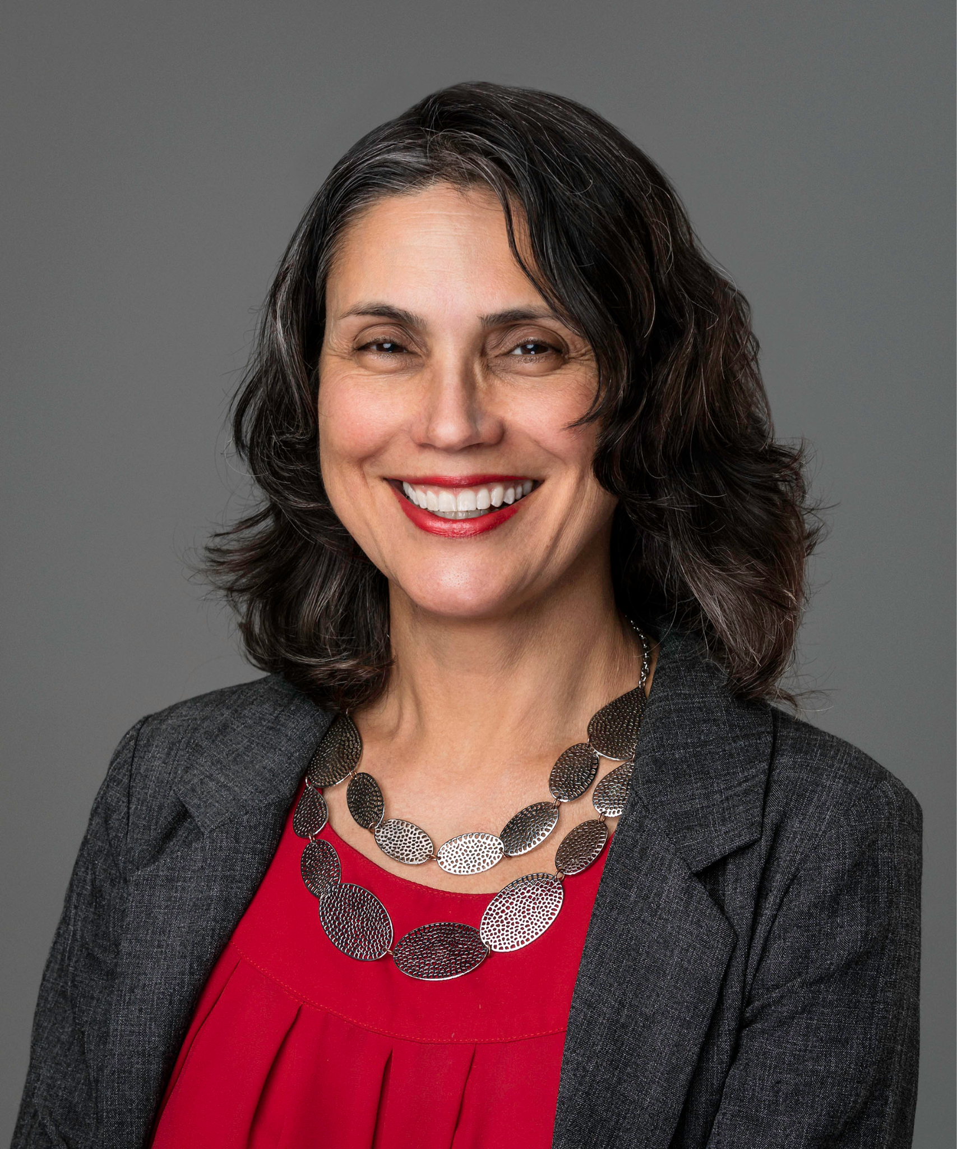
Upcoming Events
TO SPONSOR
Contact Yolanda Fintschenko, Executive Director, yolandaf@igateihub.org
for more information about becoming a sponsor of our initiatives.

